Slide 1
Coastline Detection in Satellite Imagery
CSE 472 Machine Learning Sessional Project
Group A1_3
1905016 – Zulkar Naim
1905024 – Rakib Ahsan

Slide 2
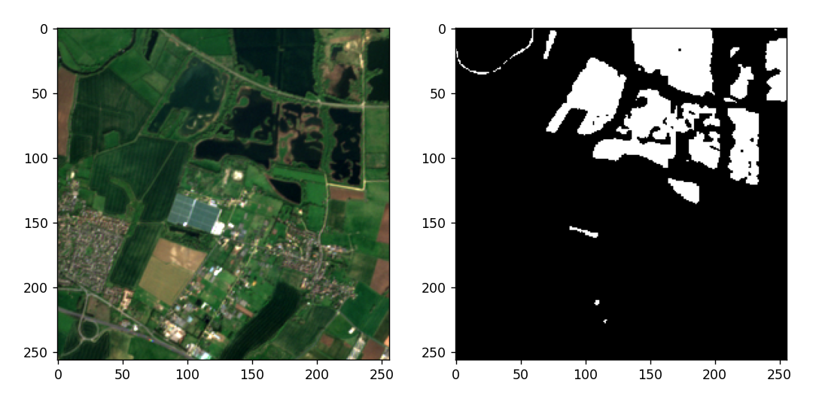
Problem Definition
Coastline detection in satellite imagery: A deep learning approach on new benchmark data
Automatic coastline extraction through enhanced sea-land segmentation by modifying Standard U-Net
Semantic segmentation of coastal aerial/satellite images using deep learning techniques: An application to coastline detection
Sentinel – 2 (13 bands)
Landsat – 8 (11 bands)

Slide 3
Dataset
Link: https://openmldata.ukho.gov.uk/
Input: 256 x 256 x 12 Sentinel-2 images
Output: 256 x 256 x 1 binary mask (1 for water body, 0 for land)
Dataset size:
26,468 training samples and 100 independent test samples
Images containing both classes are 9013
approx. 18 GB (zip)
Alt. Dataset: Link
Samples from different satellites
RGB channels only

Slide 4
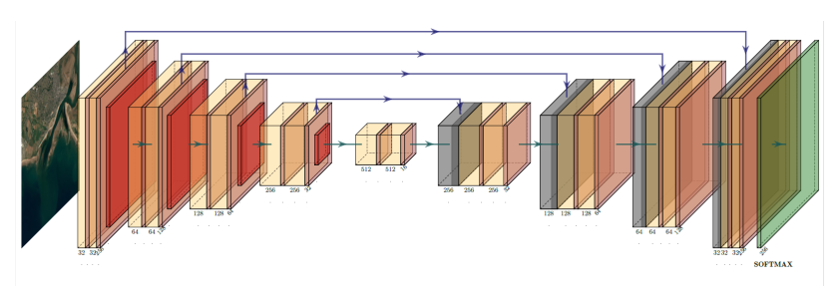
Proposed Solution
Paper Contribution
Architecture: U-net
Benchmarking:
Cross-entropy loss (CXE)
Sørensen–Dice loss (SDL)
Edge-weighted Loss Functions (W-SDL)
Sobel-edge loss (Sobel)
Our Solution
State-of-the-art segmentation models
DeepLabV3
Vision Transformer based models
Using proper loss functions to address class imbalance
Focal loss
Dice loss
A more generalized model compatible with different of dataset and satellite imagery.

Slide 5
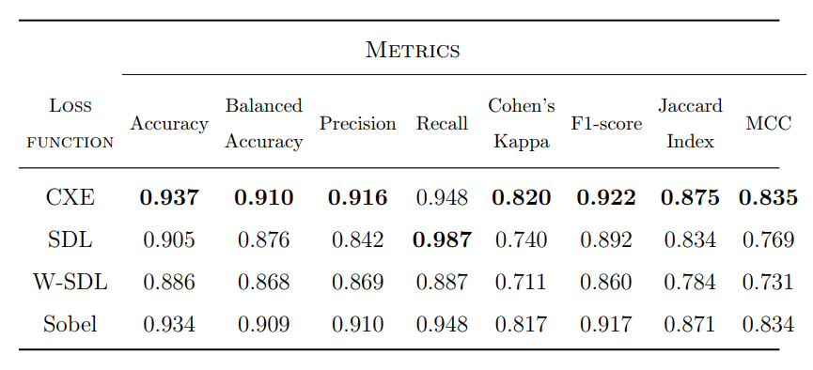
Performance Metric

